Slide 1

With the name of Allah, Who is the most Gracious and Merciful

Slide 2
Asymptotic Notations
Asymptotic notations are mathematical Notations used in computer science and mathematics to describe the efficiency of algorithms and the rate of growth of functions.
They provide a way to analyze the performance of algorithms in terms of their behavior as the input size approaches infinity.
Asymptotic notations give us an idea of how good a given algorithm is compared to others.
Let us see the mathematical definition of "order of now.

Slide 3
THE THREE MOST COMMONLY USED ASYMPTOTIC NOTATIONS ARE:
Big O Notation (O):
Omega Notation (Ω):
Theta Notation (Θ):
.

Slide 4
Big O Notation (O):
It represents an upper bound on the growth rate of an algorithm.
If a function f(n) is O(g(n)), it means that there exists a constant factor C and a value “n₀” such that for all “n” greater than or equal to “n₀”, f(n) is bounded above by C * g(n).
Let us see the mathematical definition of "order of now.

Slide 5
If f(n), describe the running time of an algorithm, f(n) is O (g(n)) ,
If there exists a positive constant “C” and “no” such that
0 ≤ f(n) ≤ c.g(n) ∀ n ≥ n₀
“n” is a variable representing the input size or some parameter in an algorithm.
“no” is a constant (threshold or starting point) indicating the minimum value for n from which the inequality is satisfied.

Slide 6

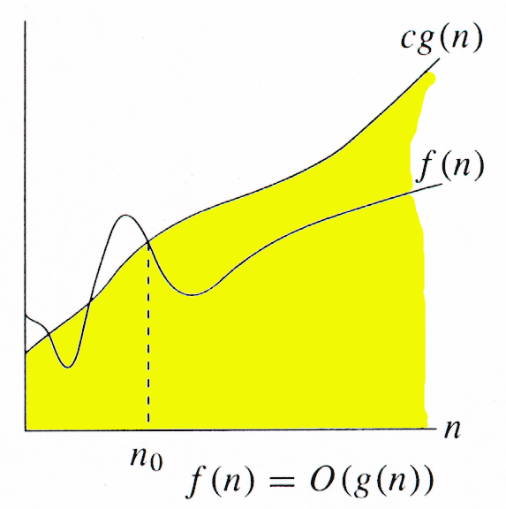
Big-Oh Notation
0 ≤ f(n) ≤ c.g(n) ∀ n ≥ n₀
g(n) is an asymptotic upper bound for f(n).
Wajahat Akbar Advanced Algorithms Analysis and Design

Slide 7
Examples
Examples
Example 1: Prove that 2n² ∈ O(n³)
Proof:
Assume that f(n) = 2n² , and g(n) = n³
f(n) ∈ O(g(n)) ?
Now we have to find the existence of c and n₀
f(n) ≤ c.g(n)  2n² ≤ c.n³
if we take, c = 1 and n₀= 2 OR
c = 2 and n₀= 1 then
2n² ≤ c.n³
Hence f(n) ∈ O(g(n)), c = 1 and n₀= 2
Wajahat Akbar Advanced Algorithms Analysis and Design

Slide 8
Examples
Examples
Example 2: Prove that n² ∈ O(n²)
Proof:
Assume that f(n) = n² , and g(n) = n²
Now we have to show that f(n) ∈ O(g(n))
Since
f(n) ≤ c.g(n)  n² ≤ c.n²  1 ≤ c, take, c = 1, n₀= 1
Then
n² ≤ c.n² for c = 1 and n ≥ 1
Hence, 2n² ∈ O(n²), where c = 1 and n₀= 1
Wajahat Akbar Advanced Algorithms Analysis and Design

Slide 9
Thank You
Google colab: https://colab.research.google.com/drive/1ogNFz8GvbioaTcVKUmeBYa2VRunx9xuV?usp=sharing

